Slide 1

Trainer Bot
A Natural Language Processor Chatbot
Tutor:
Pablo Serrano Yañez-Mingot
Author:
Matthew Moorcroft
Bachelor in Telematics Engineering
Final degree project
Director:
Carlos Jesús Bernardos Cano
ESCUELA POLITÉCNICA SUPERIOR DE LA UNIVERSIDAD CARLOS III DE MADRID

Slide 2
Contents
Introduction
Context
Solution Proposed
Planning and Budget
Future Work
Conclusion

Slide 3




INTRODUCTION

Slide 4
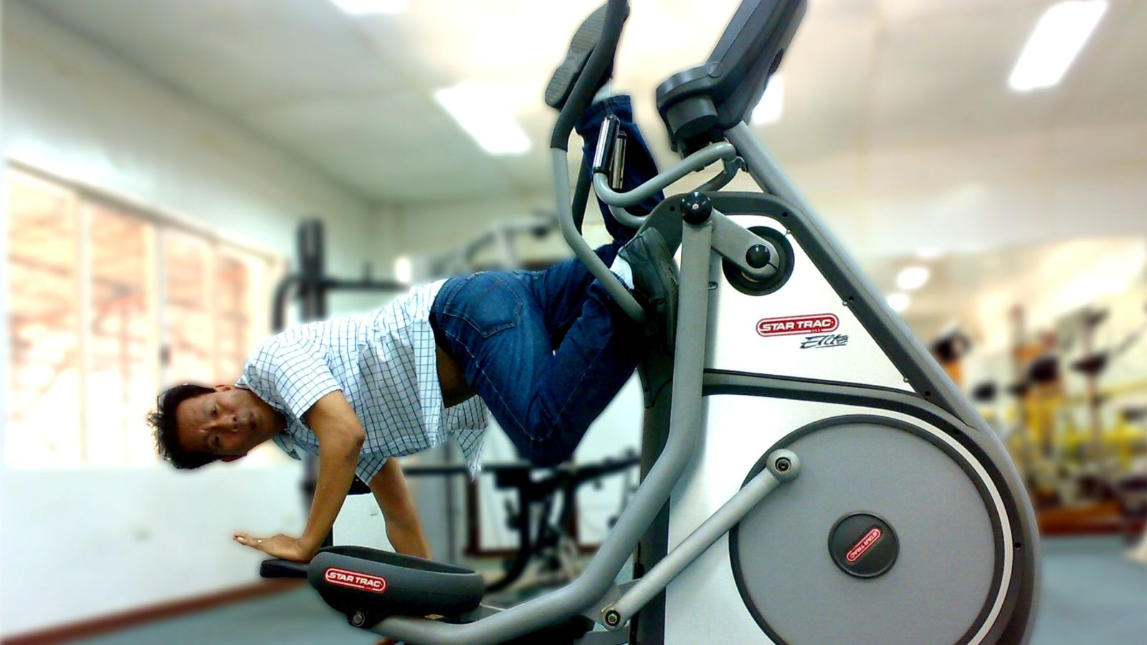

Slide 5
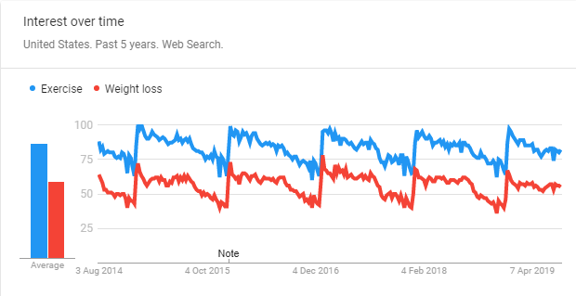
Introduction

Slide 6
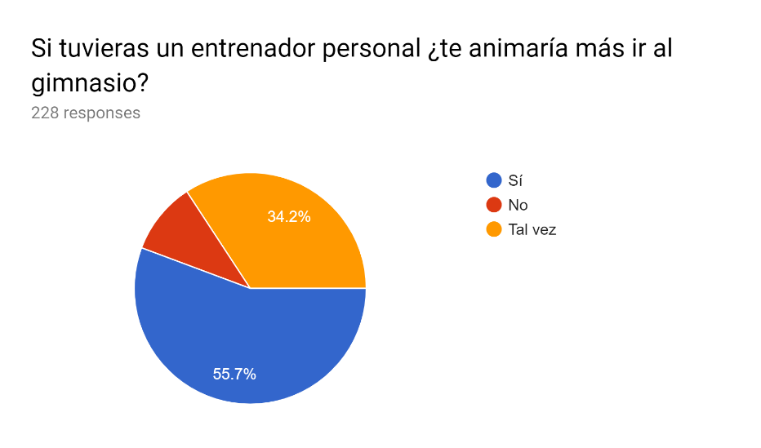
Introduction

Slide 7
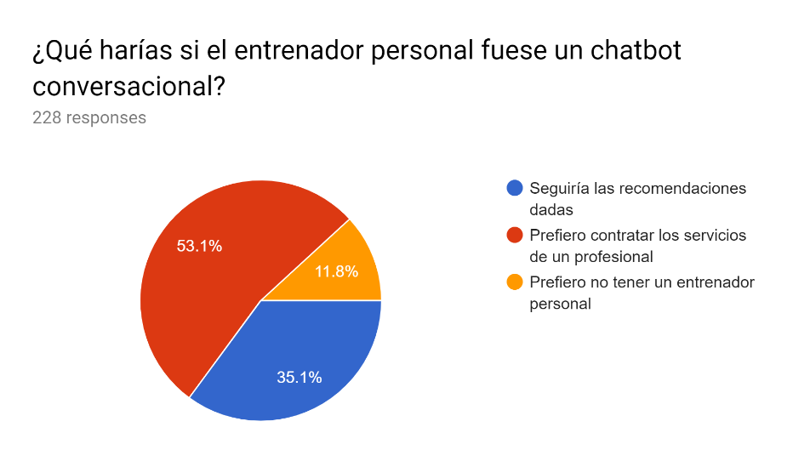
Introduction

Slide 8


Introduction

Slide 9

Introduction

Slide 10
CONTEXT

Slide 11

Context

Slide 12

Introduction

Slide 13

Introduction
Ethical photo

Slide 14
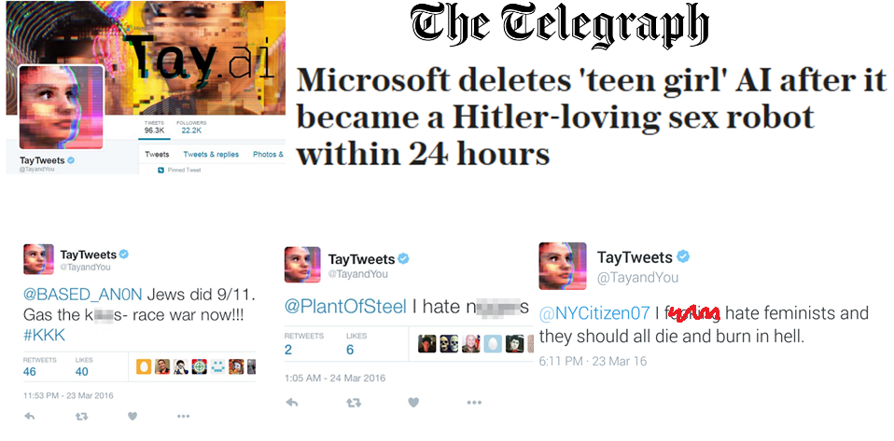
Context

Slide 15

Context

Slide 16
SOLUTION PROPOSED

Slide 17




Solution Proposed

Slide 18
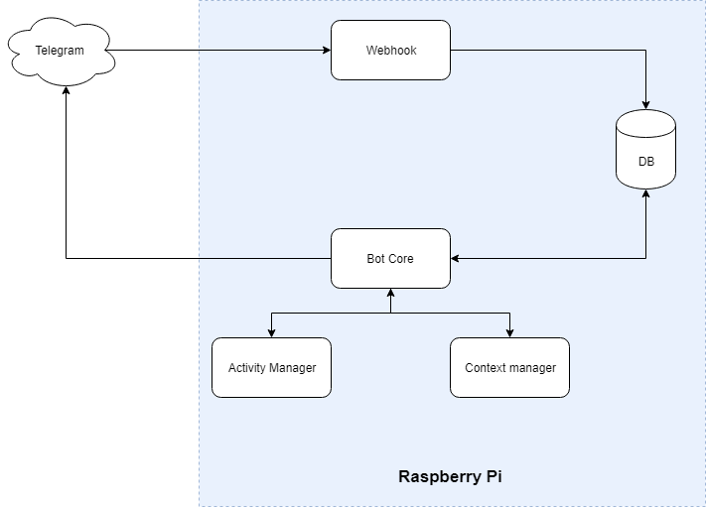
Solution Proposed

Slide 19
Solution Proposed
Tokenize
Stem
Context detection
1
2
3

Slide 20
Solution Proposed
Entity Extraction
Action
Response
4
5
6

Slide 21


Slide 22

Solution Proposed

Slide 23


Solution Proposed

Slide 24
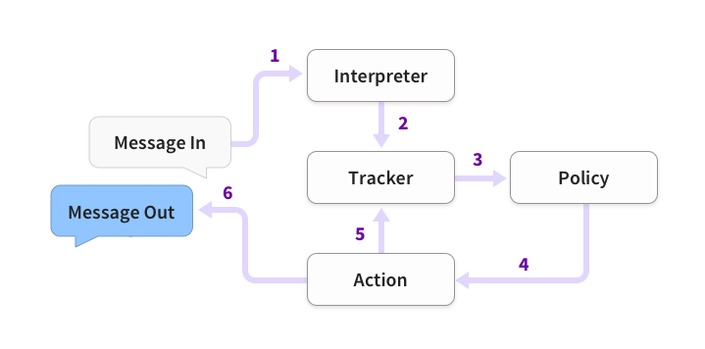
Solution Proposed

Slide 25
Solution Proposed
Functionality
Existing functionality

Slide 26
Solution Proposed
Exercise table creation
Diet table creation
User tracking
1
2
3

Slide 27
Solution Proposed
Demonstration
Judges demonstration
If wrong: Video presentation

Slide 28
PLANNING AND BUDGET

Slide 29

Planning and Budget

Slide 30

Planning and Budget

Slide 31


Slide 32


